Slide 1
Green Ammonia Plant Optimization Model Setup and Flow
5/22 Week

Slide 2
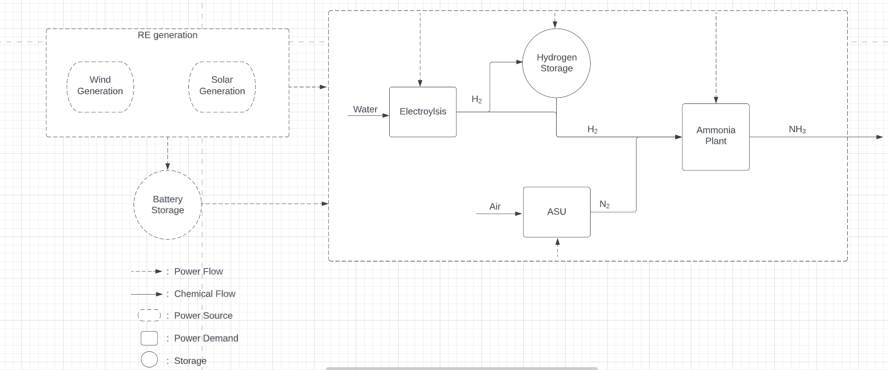
*Don’t have H₂ fuel cell due to short term storage focus

Slide 3
Model requirement 1: decide capacity of plants
Decide the capacity (how big) of plants
RE generation capacities
Battery storage size
Hydrogen storage size
Electroyzer capacity
ASU capacity
Ammonia plant capacity

Slide 4
Model requirement 2: decide operations of plants on hourly timescale to meet production demands
Battery storage
Charge
Total charge
Discharge
Hydrogen storage
Store
No flow
Deploy
Electroyzer
Produce H₂
Don’t produce H₂
ASU capacity
Produce N₂
Ammonia plant capacity
Produce NH₃

Slide 5
Model inputs
RE data
Capacity factors of wind and solar
Input sheet
Various technical parameters for system setup (can show the sheet)

Slide 6
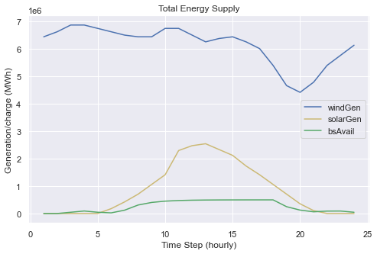
Dummy data run through of model: Energy Generation

Slide 7
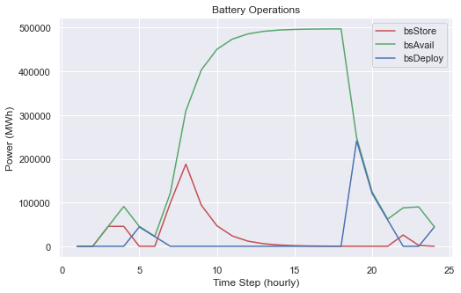
Battery Operations: store when high RE on islanded grid, discharge later in the day

Slide 8
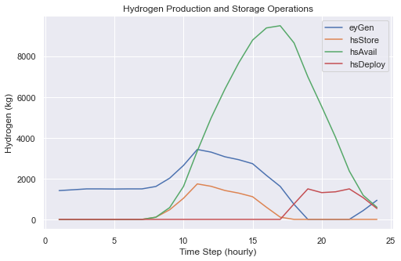
Hydrogen Production and storage: store with high RE and then deploy when solar drops off

Slide 9
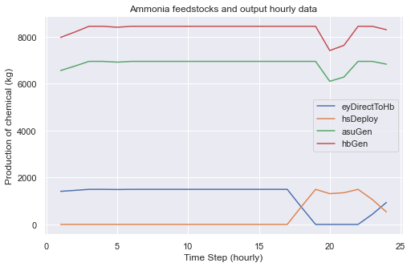
Ammonia and ASU production relatively constant with H2 direct from EY, then drops off w/ REs

Slide 10
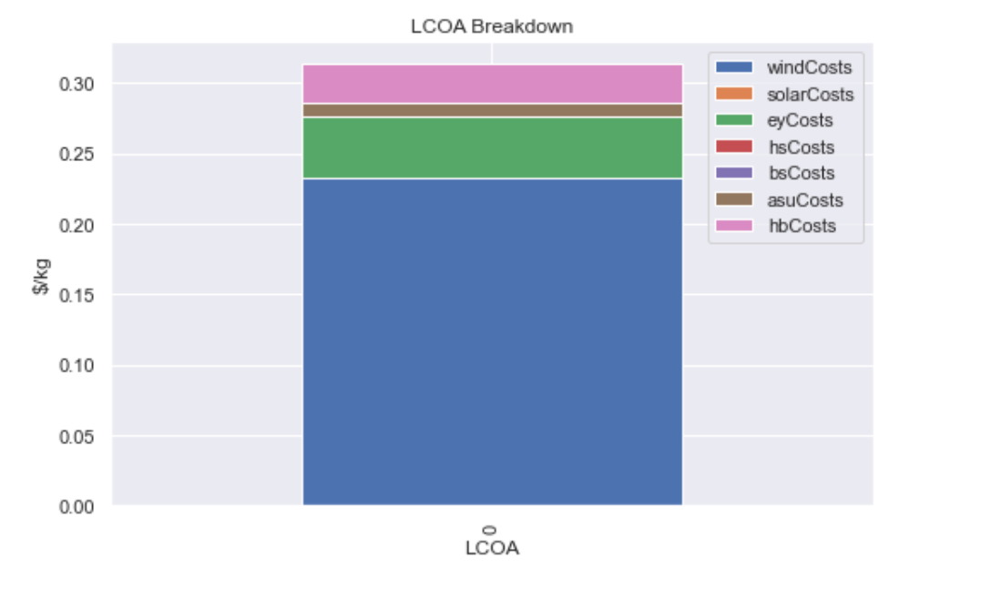
What the final outcome will look like (will develop it so its more detailed-split OPEX and CAPEX for each tech)

Slide 11
Next Steps
Clarify plant structure looks correct and pricing mechanisms are reflective
Single hydrogen/battery storage unit
No ammonia storage
Only economies of scale come from EY units which the user will have to input stack sizes

